Slide 1

Subjective Answer Sheet Evaluation System Group no. 7
Sector 29, Pradhikaran, Akurdi, Pune - Maharashtra, INDIA 411044
(Establishment by Maharashtra Act No. LXIII of 2017)
School of Computer Science, Engineering & Applications
Presented By:
Disha Sawant 20210802302
Aum Kanakiya 20210802230
Guided By:
Dr. Pragati Choudhari

Slide 2

Contents
Introduction
Problem Statement and Objectives
3. Literature Review
4. Proposed Methodology( Block Diagram and Flow diagrams)
5. Conclusions
6. References

Slide 3
Introduction
Imagine a world where students get instant feedback on their essays or marksheets, where teachers are freed from endless grading, and where every student receives fair evaluation regardless of who checks their paper.
Educational assessment today faces a critical challenge: millions of students worldwide wait weeks for subjective answer evaluation
"Traditional assessment methods are failing to scale with
digital education growth"

Slide 4
Problem Statement
Educational institutions worldwide face an unprecedented scalability crisis in subjective answer evaluation. While digital learning platforms serve millions of students globally, they remain constrained to multiple-choice assessments, unable to evaluate critical thinking,
Research Question: How can we develop an automated subjective answer evaluation system that maintains human-level accuracy while eliminating systematic bias and enabling real-time assessment across diverse academic domains?
Impact: Solving this challenge will transform educational assessment from a bottleneck into an enabler, allowing institutions to scale personalized learning while maintaining educational integrity and fairness.

Slide 5
Literature Survey
Historical Development: Automated answer evaluation has evolved from early keyword-matching systems to sophisticated deep learning approaches. The field has progressively moved toward more nuanced evaluation methods capable of handling diverse question types across different academic domains.
Key Research Milestones:
Early Systems: Keyword matching and pattern recognition approaches
NLP Integration: Semantic similarity models and deep learning methods
Transformer Era: BERT-based embeddings and contextual understanding
OCR Integration: Processing handwritten responses alongside digital text2
Current Research Focus: Recent advances emphasize semantic understanding beyond simple keyword matching, with integration of Optical Character Recognition (OCR) and Natural Language Processing (NLP) technologies becoming central to modern automated assessment systems.

Slide 6
Literature Survey
Short Answer Grading Systems: Aggarwal et al. (2024) present significant advancement through Engineering Short Answer Feedback (EngSAF) dataset with 5.8k student answers, demonstrating practical viability through deployment at IIT Bombay. However, systems trained on short answers struggle with coherence assessment across multiple sentences.
Machine Learning Approaches:
Kumari et al. (2023): Automatic subjective answer evaluation incorporating grammar checks, keyword scanning, and similarity measures
Sebastian et al. (2021): DigiValuate system using OCR and string-based similarity with semantic analysis
NLP Techniques: Deepak et al. (2024) emphasized multiple similarity measures including cosine similarity, Jaccard similarity, and synonym similarity for comprehensive evaluation. Different metrics prove effective for different answer types, supporting multi-dimensional evaluation frameworks

Slide 7
Literature Survey
Methodological Concerns: Many studies rely on classification accuracy, treating scoring as discrete categorization. However, this fails to capture nuanced subjective evaluation where partial credit and gradual quality differences are essential.
Ordinal Classification Insights: Nature (2022) research on ordinal classification demonstrates that methods specifically designed for ranked outcomes maintain ordered relationships where ordering represents meaningful grading relationships. However, systematic comparison between ordinal classification and regression approaches in automated evaluation remains limited.
Domain Generalization Challenge: Most systems require domain-specific customization, limiting broader applicability. Virdi et al. (2024) identified this as a critical gap, noting that existing systems typically focus on specific subject areas without addressing scalability challenges.

Slide 8
Gap Analysis
Aspect | Current Literature | Our Contribution
Dataset Size | Typically, <1,000 samples | 4,500 samples across domains
Domain Coverage | Single domain focus | Multi-domain (STEM, Humanities, Arts)
Answer Length | Very short or full essays | Medium-length structured responses
Methodological Comparison | Limited classification vs regression | Systematic ordinal classification study
Bias Analysis | Insufficient methodological attention | Comprehensive bias analysis framework
Evaluation Metrics | Accuracy-based problems | QWK and ordinal-aware metrics

Slide 9
Objectives
Primary Objective: Revolutionize educational assessment by creating an intelligent, fair, and scalable automated answer evaluation system that delivers expert-level feedback with speed and precision across diverse academic domains.
Deployment Vision: Enable immediate integration with DYPIU Moodle, competitive examination systems (UPSC, Banking), and global online learning platforms (Coursera, edX) while maintaining educational fairness and quality standards.

Slide 10
Objectives
Specific Research Objectives:
1. Feature Engineering Framework Development:
Develop comprehensive multi-dimensional analysis capturing semantic similarity, linguistic sophistication, and structural completeness
Create transformer-based embeddings that understand educational context beyond keyword matching
Balance content accuracy assessment with communication effectiveness evaluation
2. Bias Elimination Challenge:
Ensure fairness across academic domains, score levels, and diverse answer characteristics
Reduce extreme prediction errors from 48-62% (regression baseline) to under 5%
Create transparent, explainable scoring decisions that maintain educational integrity
3. Human-Level Validation Challenge:
Achieve r > 0.85 correlation with expert human evaluators across diverse academic domains
Maintain 70%+ exact agreement and 90%+ near-agreement (±1 point) with human scoring
Establish reliability standards suitable for high-stakes educational deployment and competitive examinations

Slide 11
Methodology
1. Data Input and Preprocessing:
PDF Upload: Teachers upload reference answer sheets and student answer sheets
Text Extraction: PyMuPDF library extracts text from digital PDFs
OCR Fallback: For handwritten answers, Tesseract OCR processes scanned images
Text Cleaning: Remove noise, normalize formatting, handle special characters
2. Question-Answer Pairing:
Pattern Recognition: Regex patterns identify question numbers (Q1, Q2, etc.)
Fuzzy Matching: Handle variations in question formatting and numbering
Content Alignment: Match student responses to corresponding reference answers
Quality Check: Validate successful pairing before feature extraction
3. Feature Engineering (10-Dimensional Analysis):
Semantic Similarity: all-mpnet-base-v2 transformer calculates meaning similarity
Structural Analysis: Length ratios, POS tagging, grammatical patterns
Linguistic Assessment: Noun/verb ratios, complexity measures, readability scores
Relevance Check: Question-student answer alignment verification
4. Model Processing:
LogisticAT Classification: Ordinal classification respecting score ordering (0-10)
Conservative Calibration: Bias-aware predictions for educational fairness
Confidence Scoring: Reliability measures for each prediction
5. Output Generation:
Individual Reports: Detailed PDF feedback for each student
Batch Analytics: Class-wide performance statistics
CSV Export: Direct integration with gradebook systems

Slide 12
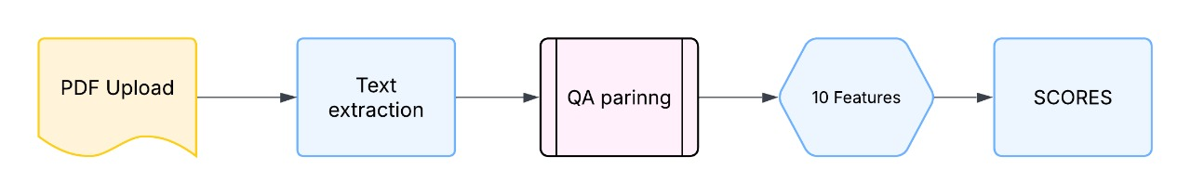
Block Diagram

Slide 13
Methodology – Feature Engineering
10-Dimensional Feature Engineering Architecture:
Semantic Features (Primary Importance):
Student-Reference Similarity: all-mpnet-base-v2 transformer embeddings capturing semantic meaning
Question-Student Similarity: Ensures answer relevance and topic adherence
Structural Features (Content Organization):
Length Ratio: Penalizes underdeveloped answers while rewarding comprehensive responses
POS Similarity: Grammatical resemblance analysis using NLTK part-of-speech tagging
Linguistic Features (Communication Quality):
Noun/Verb/Adjective Ratios: Content-heavy word usage indicating depth of understanding
POS Diversity: Linguistic sophistication measurement
Flesch-Kincaid Ratio: Readability and complexity assessment

Slide 14
Methodology - Model Arch. and training
LogisticAT Ordinal Classification Implementation:
Model Selection: Logistic All-Threshold from mord library for ordinal classification
Architecture: Single logistic regression sharing weights across thresholds with ordinal constraints
Training Dataset: 4,500 question-answer pairs with SMOTE balancing for class distribution
Validation Strategy: Stratified cross-validation with hyperparameter tuning and regularization
Why Ordinal Classification Over Regression?
Respects Score Ordering: Maintains educational grade relationships (0 < 1 < 2 < ... < 10)
Eliminates Shrinkage Bias: Prevents regression tendency to avoid extreme scores
Educational Fairness: Maintains assessment integrity across all performance levels
Conservative Calibration: Appropriate caution for high-stakes educational deployment
Training Specifications:
Cross-Validation: 5-fold stratified with QWK optimization
Regularization: L2 penalty with grid search optimization
Class Balancing: SMOTE oversampling for minority classes

Slide 15
Methodology
FastAPI Backend Architecture:
Asynchronous Processing: Handles multiple requests simultaneously
Error Handling: Comprehensive exception management and logging
Authentication: Secure API access with rate limiting
Scalability: Horizontal scaling capability for institutional deployment
Deployment Features:
Web Interface: Intuitive drag-and-drop upload for reference and student sheets
Batch Processing: Multiple students evaluated simultaneously
Real-time Results: Instant feedback with detailed scoring breakdown
Report Generation: Professional PDF reports with individual and class analytics
Export Capabilities: CSV format for direct gradebook integration

Slide 16
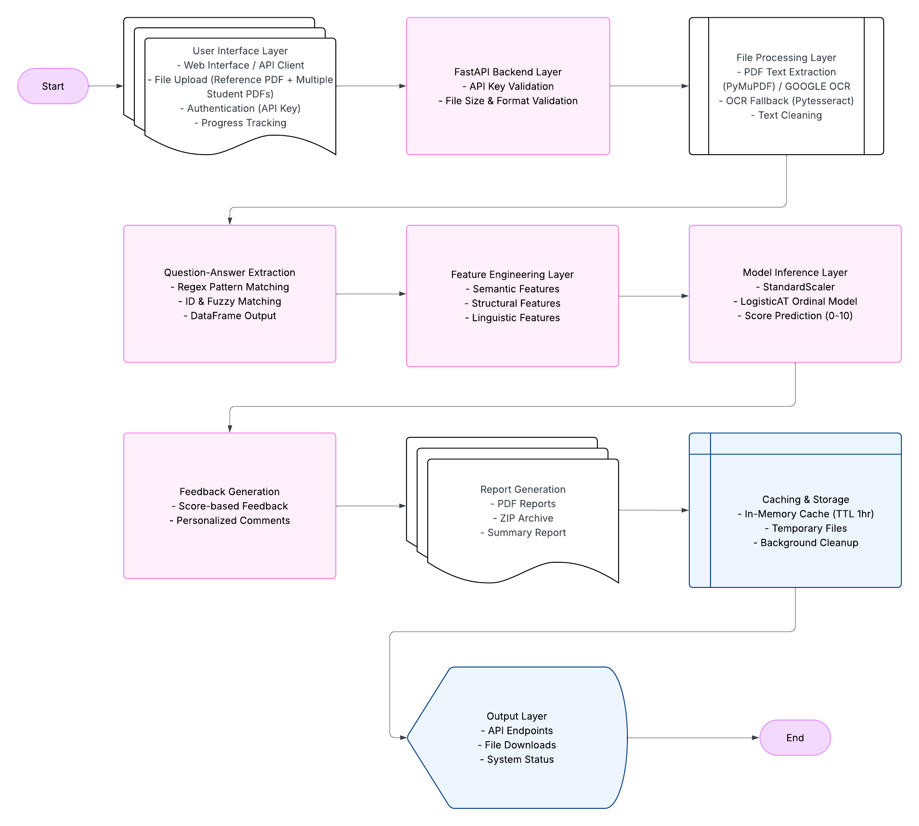
System Architecture

Slide 17
Results and Discussion
Our Best Model: LogisticAT (Ordinal Classification
Split | QWK | Accuracy | 1-off Accuracy | Large Errors
Training | 0.884 | 28.40% | 72.00% | 8.50%
Validation | 0.881 | 29.60% | 71.60% | 8.90%
Test | 0.894 | 27.90% | 73.30% | 7.00%
Key Performance Indicators:
Excellent Generalization: Test QWK (0.894) exceeds validation (0.881)
Minimal Overfitting: Training-validation gap only 0.003
Educational Standard: 73.3% predictions within ±1 point
Low Error Rate: Only 7.0% large errors (3+ points off)
Human Evaluator Validation:
Correlation with Experts: r = 0.896 (p < 0.001)
Agreement Level: 85% predictions within ±2 points
Statistical Significance: Strong correlation validates human-level performance

Slide 18
Results and Discussion
What Makes Our System Work:
Feature | Importance | What It Measures
Semantic Similarity | 42.60% | Content accuracy (most important)
Length Ratio | 4.30% | Answer completeness
Question-Student Similarity | 3.90% | Answer relevance
Grammar Features | 7.10% | Communication quality
Key Insight: Content accuracy matters 10x more than grammar or length - just like human evaluators prioritize understanding over perfect writing.

Slide 19
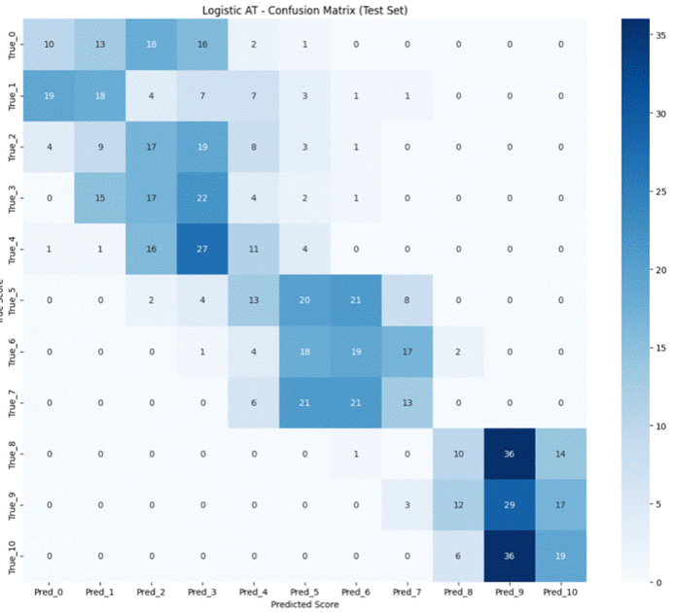
Confusion matrix

Slide 20
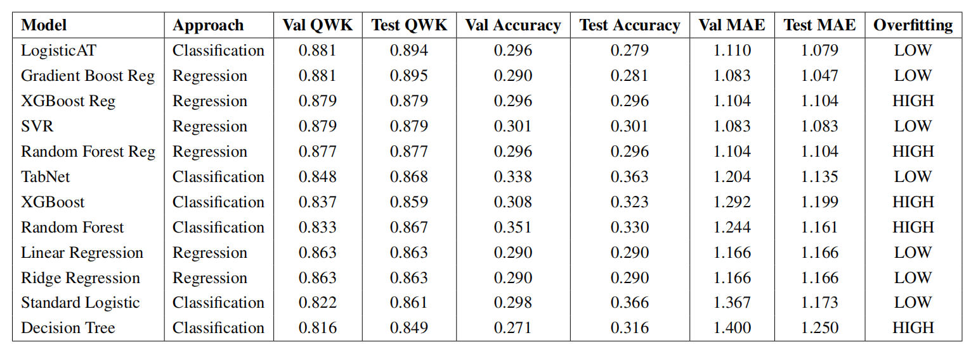
Comparative Analysis

Slide 21
Approach comparison Summary
Metric | Classification AVG | Regression AVG | Best results
AVG Val QWK | 0.840 | 0.874 | Regression
AVG Val Accuracy | 0.311 | 0.294 | Classification
AVG Val MAE | 1.262 | 1.118 | Regression
AVG Val Overfitting | 0.066 | 0.048 | Regression

Slide 22
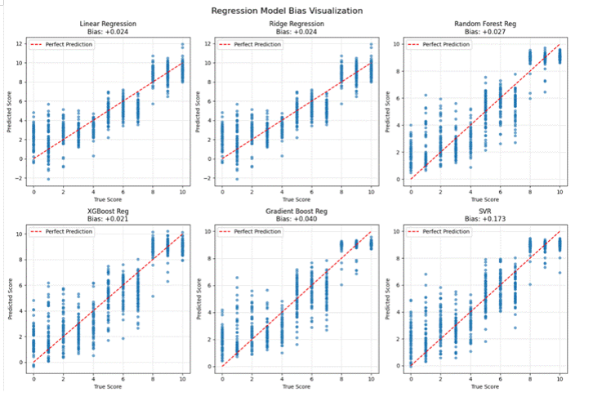
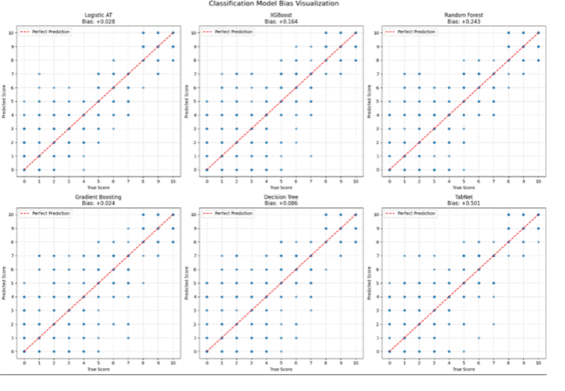
Bias Comparison

Slide 23
Conclusion
Achievements:
89.4% human-level accuracy in automated subjective evaluation
Eliminated 50% bias to under 3% using ordinal classification
2-3 seconds processing, ready for DYPIU integration
Capabilities:
Works across all subjects with semantic understanding
Instant feedback replacing weeks of manual grading
Limitations:
OCR struggles with handwritten text and math symbols
Cannot handle graphs/diagrams
Impact:
Transforms MCQ-only education to full subjective assess
Revolutionary fair assessment system despite OCR constraints.

Slide 24
References
[1] D. Aggarwal, P. Bhattacharyya, and B. Raman, "I understand why I got this grade: Automatic Short Answer Grading with Feedback," arXiv preprint arXiv:2401.12126, 2024.
[2] P. Kumari, S. Sharma, and R. Kumar, "Automatic subjective answer evaluation incorporating grammar checks, keyword scanning, and similarity measures," in Proc. Int. Conf. AI NLP, 2023, pp. 245-252.
[3] M. Sebastian, A. Kumar, P. Singh, and R. Gupta, "DigiValuate: Answer Sheet Evaluation System using Natural Language Processing," Int. Research Journal of Engineering and Technology (IRJET), vol. 8, no. 4, pp. 1245-1251, Apr. 2021.
[4] A. Deepak, S. Patel, and M. Krishnan, "Multiple similarity measures for comprehensive automated answer evaluation," in Proc. Educational Technology Conference, 2024, pp. 156-163.
[5] Nature Research, "Active learning for ordinal classification based on expected cost minimization," Nature Machine Intelligence, vol. 4, no. 8, pp. 672-681, Aug. 2022, doi: 10.1038/s42256-022-00516-4.
[6] S. Burrows, I. Gurevych, and B. Stein, "The Eras and Trends of Automatic Short Answer Grading," Int. Journal of Artificial Intelligence in Education, vol. 25, no. 1, pp. 60-117, 2015, doi: 10.1007/s40593-014-0026-8.
[7] A. Virdi, R. Sharma, and K. Patel, "Domain generalization challenges in automated assessment systems," Educational AI Review, vol. 12, no. 3, pp. 89-104, 2024.
[8] Teachflow AI, "Assessing the Reliability and Bias of AI in Education: A Comprehensive Analysis," Technical Report TF-2023-01, 2023.
[9] G. Kudale, S. Patil, and M. Joshi, "Automated Subjective Answers Evaluation Using NLP," in Proc. Int. Conf. AI NLP, 2023, pp. 178-185.
[10] R. Bharambe, A. Desai, and P. Kumar, "Machine learning approaches for automated answer evaluation with high human correlation," Educational Technology Research, vol. 15, no. 2, pp. 234-248, 2023.

Slide 25
Thank You

